Slide 1

Satan’s
If I Were
MINISTER
(part 3)

Slide 2

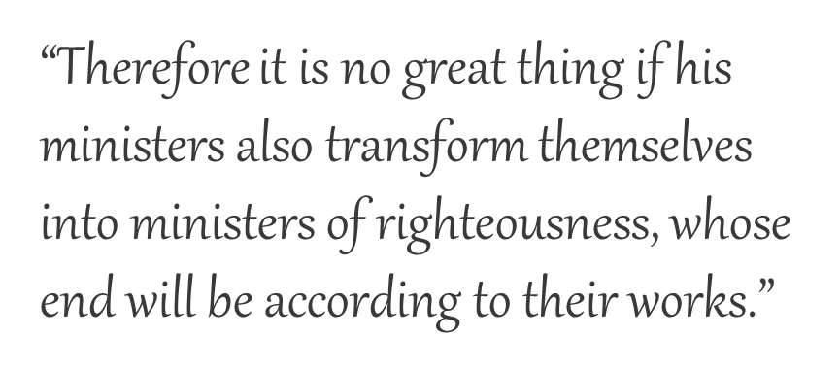
I would:
Teach that someone like me does not exist
Promote the one-man pastor system
Emphasize sincerity over truth
Embrace all forms of worship
2 Corinthians 11:15

Slide 3


If I Were
SATAN’S MINISTER
2 Corinthians 11:15
I would:
Embrace Calvinistic doctrine

Slide 4


If I were Satan’s Minister…
“Salvation is ALL of God and NONE of me.”
I would teach that salvation is wholly of grace.
—Eph. 2:5; 1 Jn. 4:10

Slide 5
“Wholly”
  to the full or entire extent : completely <a wholly owned subsidiary>
  to the exclusion of other things : solely <a book dealing wholly with herbs>
www.merriam-webster.com/dictionary/wholly

Slide 6

How can salvation be “WHOLLY” of grace if it is THROUGH faith?
“For by grace you have been saved through faith, and that not of yourselves; it is the gift of God”
Ephesians 2:8

Slide 7
WHOLLY OF GRACE?
1 John 4:10
“In this is love, not that we loved God, but that He loved us and sent His Son to be the propitiation for our sins.”
YET
1 John 4:14
“And we have seen and testify that the Father has sent the Son as Savior of the world.”
If salvation is “wholly of grace,” why is the whole world not saved?

Slide 8

BECAUSE:
If salvation is “wholly of grace,” why is the whole world not saved?
If salvation is “wholly of grace,” why is the whole world not saved?
GRACE
TITUS 2:11
“For the grace of God that brings salvation has appeared to all men”
There are many false prophets (1 Jn. 4:1)
Many are “of the world” (1 Jn. 4:5)

Slide 9
BECAUSE:
If salvation is “wholly of grace,” why is the whole world not saved?
GRACE
TITUS 2:11
“For the grace of God that brings salvation has appeared to all men”
Not everyone:
  confesses (1 Jn. 4:2, 3)
  knows God (1 Jn. 4:6)
  loves (1 Jn. 4:7, 8)
  believes (1 Jn. 5:1)
  keeps His commandments
  (1 Jn. 5:3)
MAN MUST DO SOMETHING TO SECURE GOD’S FAVOR!

Slide 10
ALL of God and NONE of Me?
MATTHEW 7:21, “Not everyone who says to Me, ‘Lord, Lord,’ shall enter the kingdom of heaven, but he who does the will of My Father in heaven.”

Slide 11
Why Was The Jailer Baptized (Acts 16:25-34)?
What did he ask?
  16:30
"Sirs, what must I do to be saved?"
probing
personal
timeless
respectful
necessity
action

Slide 12

Why Was The Jailer Baptized (Acts 16:25-34)?
What did he ask?
  16:30
What was he told to do?
  16:31
When did he believe?
  16:32-34
“Believe on the Lord Jesus Christ, and you will be saved”
To obey in baptism is to believe on the Lord Jesus Christ!

Slide 13
If salvation is wholly of grace (all of God and none of me), why was the jailer told to believe? Why was he baptized that very hour?

Slide 14
The Road To Your Destination
“How Far to My Destination?”
B
“How Far to My Destination?”
“How Far to My Destination?”
Different Answers Depending On Where You Are
A

Slide 15
The Road To Salvation
Acts 2:37
Acts 16:30
Acts 22:10
B
“Arise and be baptized, and wash away your sins, calling on the name of the Lord” (Acts 22:16)
?
“What Must I Do to be Saved?”
?
“Repent, and let every one of you be baptized in the name of Jesus Christ…” (Acts 2:38)
?
A
“Believe on the Lord Jesus Christ” (Acts 16:31)

